Slide 2
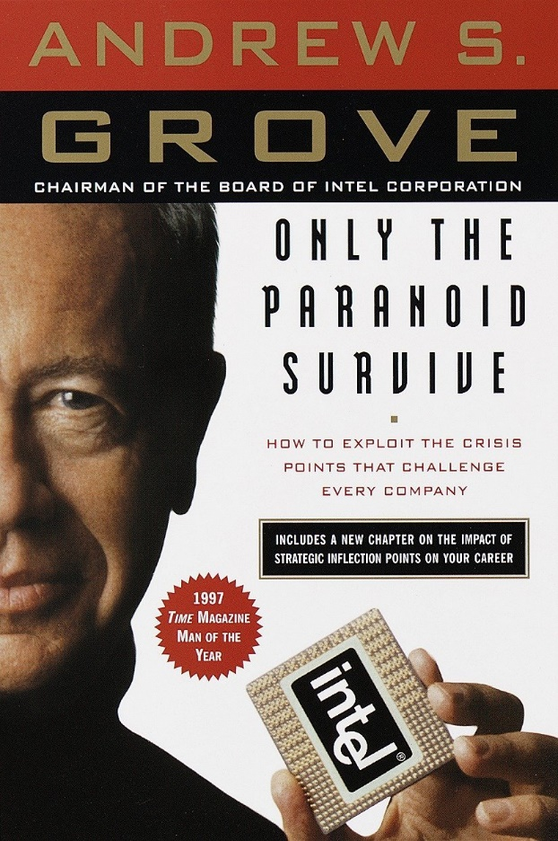
Only the Paranoid Survive by Andrew Grove
Andy Grove, founder and former CEO of Intel shares his strategy for success as he takes the reader deep inside the workings of a major company in Only the Paranoid Survive. Under Andy Grove's leadership, Intel became the world's largest chip maker and one of the most admired companies in the world. In Only the Paranoid Survive, Grove reveals his strategy for measuring the nightmare moment every leader dreads--when massive change occurs and a company must, virtually overnight, adapt or fall by the wayside--in a new way. Grove calls such a moment a Strategic Inflection Point, which can be set off by almost anything: mega-competition, a change in regulations, or a seemingly modest change in technology. When a Strategic Inflection Point hits, the ordinary rules of business go out the window. Yet, managed right, a Strategic Inflection Point can be an opportunity to win in the marketplace and emerge stronger than ever. Grove underscores his message by examining his own record of success and failure, including how he navigated the events of the Pentium flaw, which threatened Intel's reputation in 1994, and how he has dealt with the explosions in growth of the Internet. The work of a lifetime, Only the Paranoid Survive is a classic of managerial and leadership skills.
The written & audio summary can be found on our website bestbookbits.com. So without further ado I bring you the book summary of “Only the Paranoid Survive”

Slide 3
Only the Paranoid Survive Summary
Something change
In 1994, Intel’s Pentium processors suffered from floating point bug. Surprisingly for Intel, once the consumers became aware of the bug, rather than reaching out to manufacturers, they were calling Intel directly. It became obvious at that point that Intel has become a household name. Even though it’s selling to enterprises, consumers think of it as a consumer electronics company and have same expectations of customer service.
A “10 X” change
Power, vigor, and competence of competitors – their focus and funding
Power, vigor, and competence of suppliers – are there a sufficient number of them?
Power, vigor, and competence of customers – are there few of them or a lot and how demanding are they?

Slide 4
Only the Paranoid Survive Summary
4. Power, vigor, and competence of potential competitors – what about those who are not competing today but might come in if the circumstances change?
5. The possibility of substitution – can some other product/service substitute for your product/service. This is most deadly.
6. Power, vigor, and competence of complementors – some products work well with other products. For example, cars need gasoline.
A sudden change in magnitude of these forces by an order makes it 10X force. A 10X force makes a company go through an inflection point, either the business reaches new heights, or it declines.

Slide 5
Only the Paranoid Survive Summary
The morphing of the computer industry
Till 1980, the computer industry was split along verticals competitors. They built chips, OS, as well as the application software. After an inflection point, competition became more along horizontal lines. Companies were competing solely on either the chips, OS or the application software while maintaining compatibility with other players. Compaq, Dell, and Novell became the players who understood the new battle. IBM launched OS/2 which was meant to work with other PC manufacturers. Its name rhymed with IBM’s PS/2 and the fact that IBM was competing with these manufacturers in PC business produced a lot of friction for IBM to market OS/2.
There were three rules which the successful companies like Dell, Novell, and Compaq followed

Slide 6
Only the Paranoid Survive Summary
Don’t differentiate without a difference
Don’t fight a new wave of technology instead grab it and,
instead of cost-based pricing, focus on what market will accept as a price and then work towards cutting costs to make money out of it. This will allow for economies of scale.
They’re everywhere
1. 10X change in competition: Walmart has superior logistics than others. Companies who succeeded against it did so by specializing. For example, Home Depot, Office Depot, Toys R Us, etc.

Slide 7
Only the Paranoid Survive Summary
2. 10X change in competition: Next was built around vertical industry model. It was aimed at competing against Mac, except that industry changed in the meanwhile and found itself competing against several PC manufacturers. Next saved itself by becoming a software-only company afterward.
3. 10X change in technology: From 1927 onwards, movies started to have sound. Some actors lived in denial while some accepted the change and became successful.
4. 10X change in technology: When ship containerization was introduced, Seattle and Singapore became major ports by modernizing themselves.
5. 10X change in technology: When PCs were introduced, DEC, who transitioned the world from IBM’s mainframes to DEC’s minicomputers, failed to acknowledge that PC’s would disrupt them.

Slide 8
Only the Paranoid Survive Summary
6. 10X change in customer: In 1920’s, Ford failed to acknowledge that customers are looking for more style and leisure than its standard Model T. GM won by introducing those models. Supercomputer industry (and Cray Computer Corp.) died at the end of the cold war as computing based moved to microprocessors and government spending dried up.
7. 10X change in suppliers: Travel agent commissions used to be the third largest cost for airlines after labor and fuel. Eventually, airlines started to put a cap on commissions.
8. 10X change in complementors: PC industry and Intel are mutually dependent, any changes to one impact the other. (Ashish’s note: both Intel’s processors and PC industry are struggling as of 2014).
9. 10X change in regulation: In 1906, Food and Drugs Act was passed mandating that all medicines must label their ingredients. So, things like morphine and cannabis have to be either removed, or company will lose the market share.

Slide 9
Only the Paranoid Survive Summary
10. 10X change in regulation: In 1968, FCC ruled that telephone company cannot mandate its equipment for customers. Bell System’s monopoly in equipment was lost. Its monopoly reduced even further when in 1984, AT&T finished its voluntary break up into six baby Bells. The new baby Bells learned that they need to prepare for competition. Privatization of state-owned companies produces the same impact where they either fail or learn to become good at marketing.
Why not do it ourselves?
Intel started in 1968 and by 1984, its primary revenue line, that is, memories was struggling against Japanese competitors. CEO Gordon Moore and Andy realized that if they bring in a new CEO, he will get Intel out of memory business. Therefore, they decided that Intel should get out of memory business. 4 out of 5 fabs were already producing microprocessor chips instead of memories because the fab resources were being reallocated automatically based on profits. There was a lot of political turmoil internally. Customers were not surprised since they were expecting this. The complete focused on 386 processors which became a huge success.

Slide 10
Only the Paranoid Survive Summary
Lesson: When a new CEO is brought in, usually when the company is struggling, he succeeds not because he is better but because he does not have the same emotional attachment to the obsolete past as the previous one.
Signal or Noise?
A signal which might be indicating a 10X change should be evaluated regularly, it could be noise initially and might become an important indicator later.
X-ray – Intel felt X-ray based lithography is a noise while IBM felt it’s a signal and is spending a lot of resources on it.

Slide 11
Only the Paranoid Survive Summary
RISC vs CISC – For a short period of time, there was a fear that CISC will become obsolete and RISC will take over. Intel worked on 860 series (RISC), which was backward incompatible with 386 series and 486 series (CISC). Eventually, they realized that it’s a noise and advantages which RISC has to offer over CISC are not substantial enough for PC manufacturers to make a switch.
How to differentiate between a signal and a noise?
Is your key competitor about to change – use “silver bullet test” (whom would you kill if you have only one bullet left) to find who is a key competitor.
Is your key complementor about to change – has current key complementor become less important, is there a different company taking its place.

Slide 12
Only the Paranoid Survive Summary
3. Do people seem to be “losing it” around you – you and your management were selected by evolution to be the best persons to handle original business, if it’s being disrupted, the very process which got you and your associates where you are might retard your ability to recognize the trend.
Middle management, especially in the sales, is the first one to notice that “something” has changed, they might lack perspective or expertise but have much more exposure than the top level management to outside world. Think of these individuals as messengers and never ever “shoot the messenger” for bringing bad news.
First version trap: Quality of the first version of a new technology is usually shoddy, but one should think about its long-term potential and significance assuming that the quality will eventually become good. Debates are difficult, challenging and important, it’s never clear on how to navigate inflection points and therefore, debates which bring in different perspectives are important.

Slide 13
Only the Paranoid Survive Summary
Let Chaos Reign
The inertia of Success: Senior managers prefer to spend time on same old strategies since they are good at it, they find it uncomfortable to focus on the new one and hence, fail when inflection points are encountered.
Some experimentation is necessary to prepare for inflection points. It’s better to start early when revenues and profits from current products are strong than to start late when revenues are declining and competitors have already captured significant market share.

Slide 14
Only the Paranoid Survive Summary
Rein in Chaos
To cross the chaotic valley of death (“inflection point”), one should come up with simplified directions. For example, as Intel was struggling in the memory business, a new direction was “Intel, the microcomputer company”. Such directions set up further actionable directions – e.g. for Intel, half of the managers should learn or will be replaced with people who knew the software, the resources (physical or human) should be shifted accordingly. While navigating inflection points, it’s important for everyone to aim for one single direction, don’t split the company along multiple directions, hedging is expensive and it dilutes commitment, facing competition with only half the resources is dangerous.
It’s important to make the message clear to media since employees put more weight on what they hear from outside. Executives’ calendar appointments should emphasize the new direction as well. The companies who succeed have a good dialectic between top-down (coming from CEO) and bottom-up (coming from middle-level managers) actions.

Slide 15
Only the Paranoid Survive Summary
The Internet Signal or Noise? Threat or Promise?
(Ashish’s note: This chapter is obsolete for people growing up as a part of Internet generation as it does not provide any useful knowledge)
Career Inflection Points
Be always alert and aware of changes in the environment. Keep an eye on whether your company is losing grounds to competitors (implying job change for you) or is the whole sector is being transformed (implying skill acquisition for you).
Whenever you believe that a career inflection point is coming, inactivity is dangerous, choose a direction and commit yourself fully to navigate the valley of death.

